Slide 1
Effect of hail nets and reflective ground covers on microclimate and evapotranspiration demand in an apple orchard
Presented by: Ahmed Ben Abdelkader
With: Prof. Massimo Tagliavini
Dr. Damiano Zanotelli
Email: Abenabdelkader@unibz.it
11.03.2021

Slide 2
INTRODUCTION
Nowadays, fruit growers are more aware about the necessity of protecting their orchards from extreme weather conditions: most of them are using nets in order to reduce the light intensity that could damage their production.
In addition, bicolor apple growers are applying the ground reflective covers which enhance the albedo and the light distribution within the canopy and therefore, improve the fruit color that becomes one of the main concerns for marketing reasons.

Slide 3
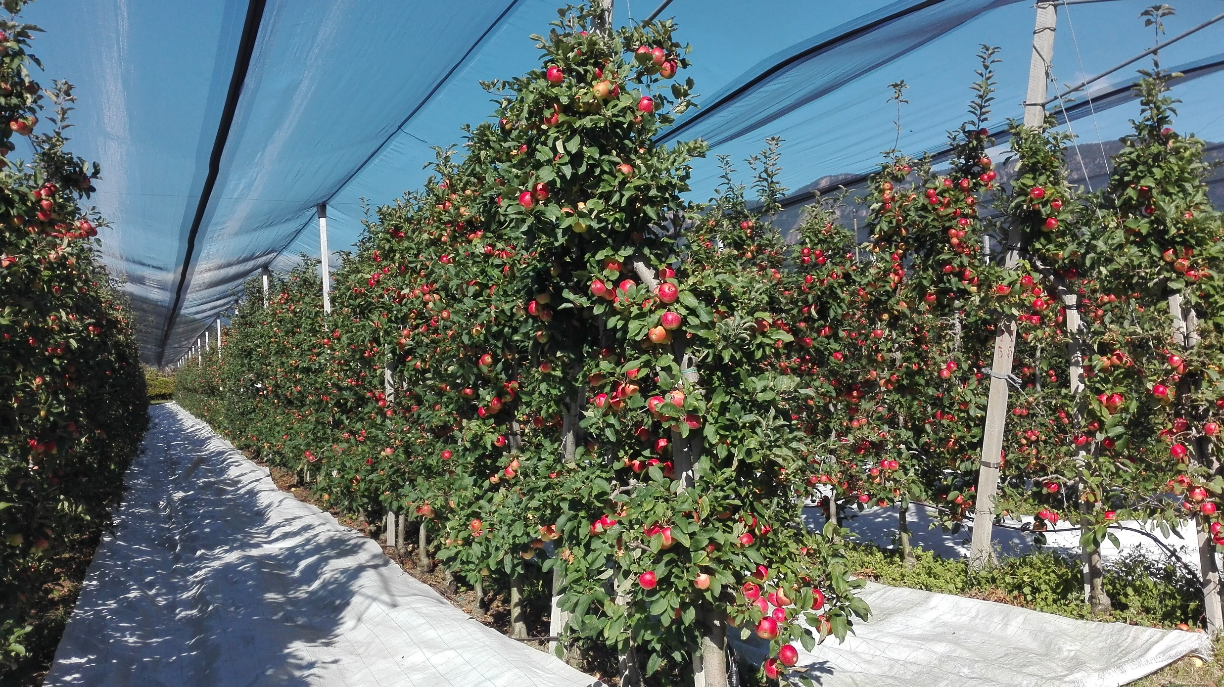
Hypothesis
The use of protective nets affects the orchard´s microclimate and reduces the evaporative demand.
The reflective strips amplify this effect.

Slide 4
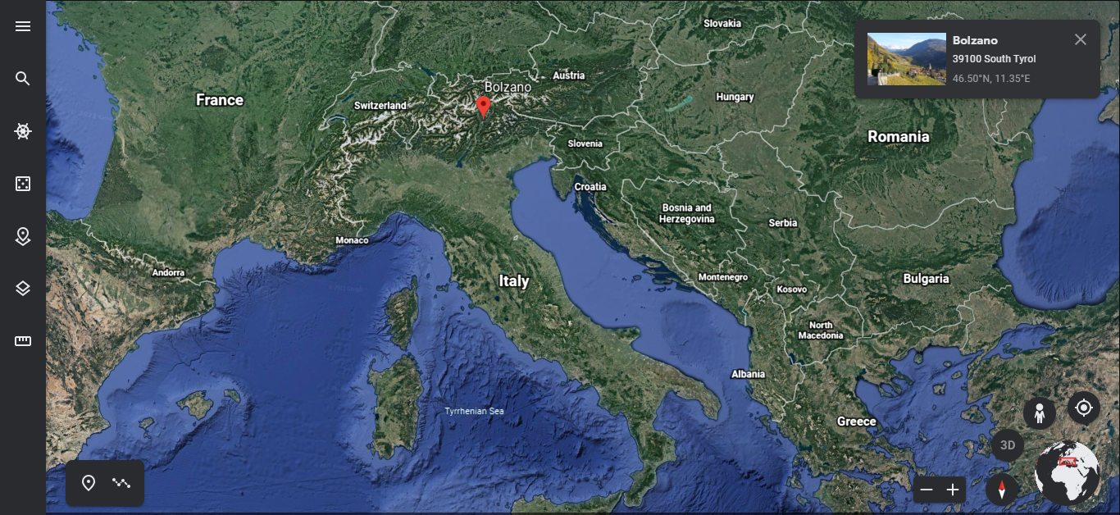
Experimental Site
Apple orchard cv. Nicoter “Kanzi” of 13 years old in Bolzano, South Tyrol, Italy
Planting density of 4160 tree/ha (3m *0.8m)
Sandy loam soil
Black anti-hail nets
White plastic reflective strips placed 2 weeks before harvest

Slide 5
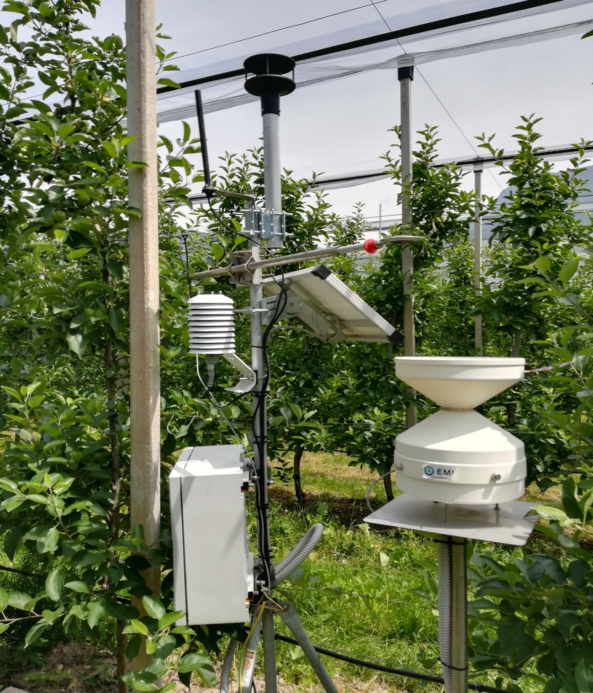
Microclimate data
Two meteorological stations have been installed in summer 2020, under and outside the nets, each station is equipped with a solar panel and connected to a datalogger (recording frequency 15 min),
Sensors:
- A thermo-hygrometer (HygroVUE5, Campbell Scientific) with a radiation shield placed at 2m above the ground for T and Rh monitoring,
- A 2D sonic anemometer (WindSonic, Gill Instruments) was placed at 2.5m to measure the two horizontal components of wind speed,
Notes:
Each station, equipped with
In 2020, two meteorological stations with data registration frequency of 15min. equipped with all instruments were installed in both inside and outside the nets-covered part of the orchard in order to control the microclimate under both situations and evaluate the ET potential by using the P-M eqt.
PS: same irrigation regimes and same managements in both conditions
PS: same irrigation management and some conditions in the two orchards

Slide 6
Microclimate data
- A 2D sonic anemometer (WindSonic, Gill Instruments) was placed at 2.5m to measure the two horizontal components of wind speed,
- A net irradiance meter (LP NET 07, Delta OHM) measuring the net solar radiation,
- A quantum sensor (SKP 215, Skye) to measure the incident (PAR) below and outside the nets,
- A rain gauge (ARG100, EML) to quantify the effective precipitations.
Potential ET was evaluated by applying P-M (FAO-56) equation.
Notes:
Each station, equipped with
In 2020, two meteorological stations with data registration frequency of 15min. equipped with all instruments were installed in both inside and outside the nets-covered part of the orchard in order to control the microclimate under both situations and evaluate the ET potential by using the P-M eqt.
PS: same irrigation regimes and same managements in both conditions
PS: same irrigation management and some conditions in the two orchards

Slide 8
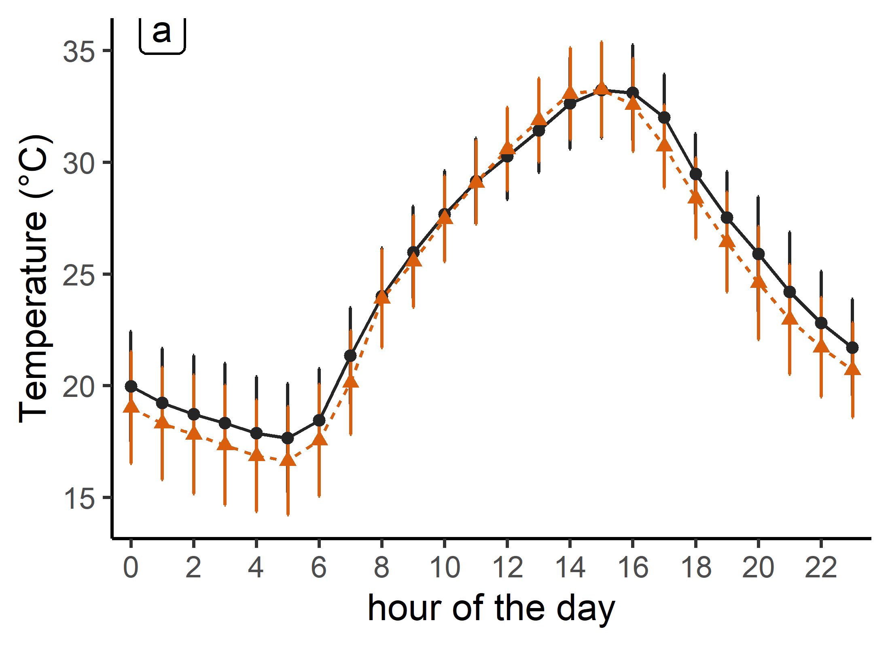
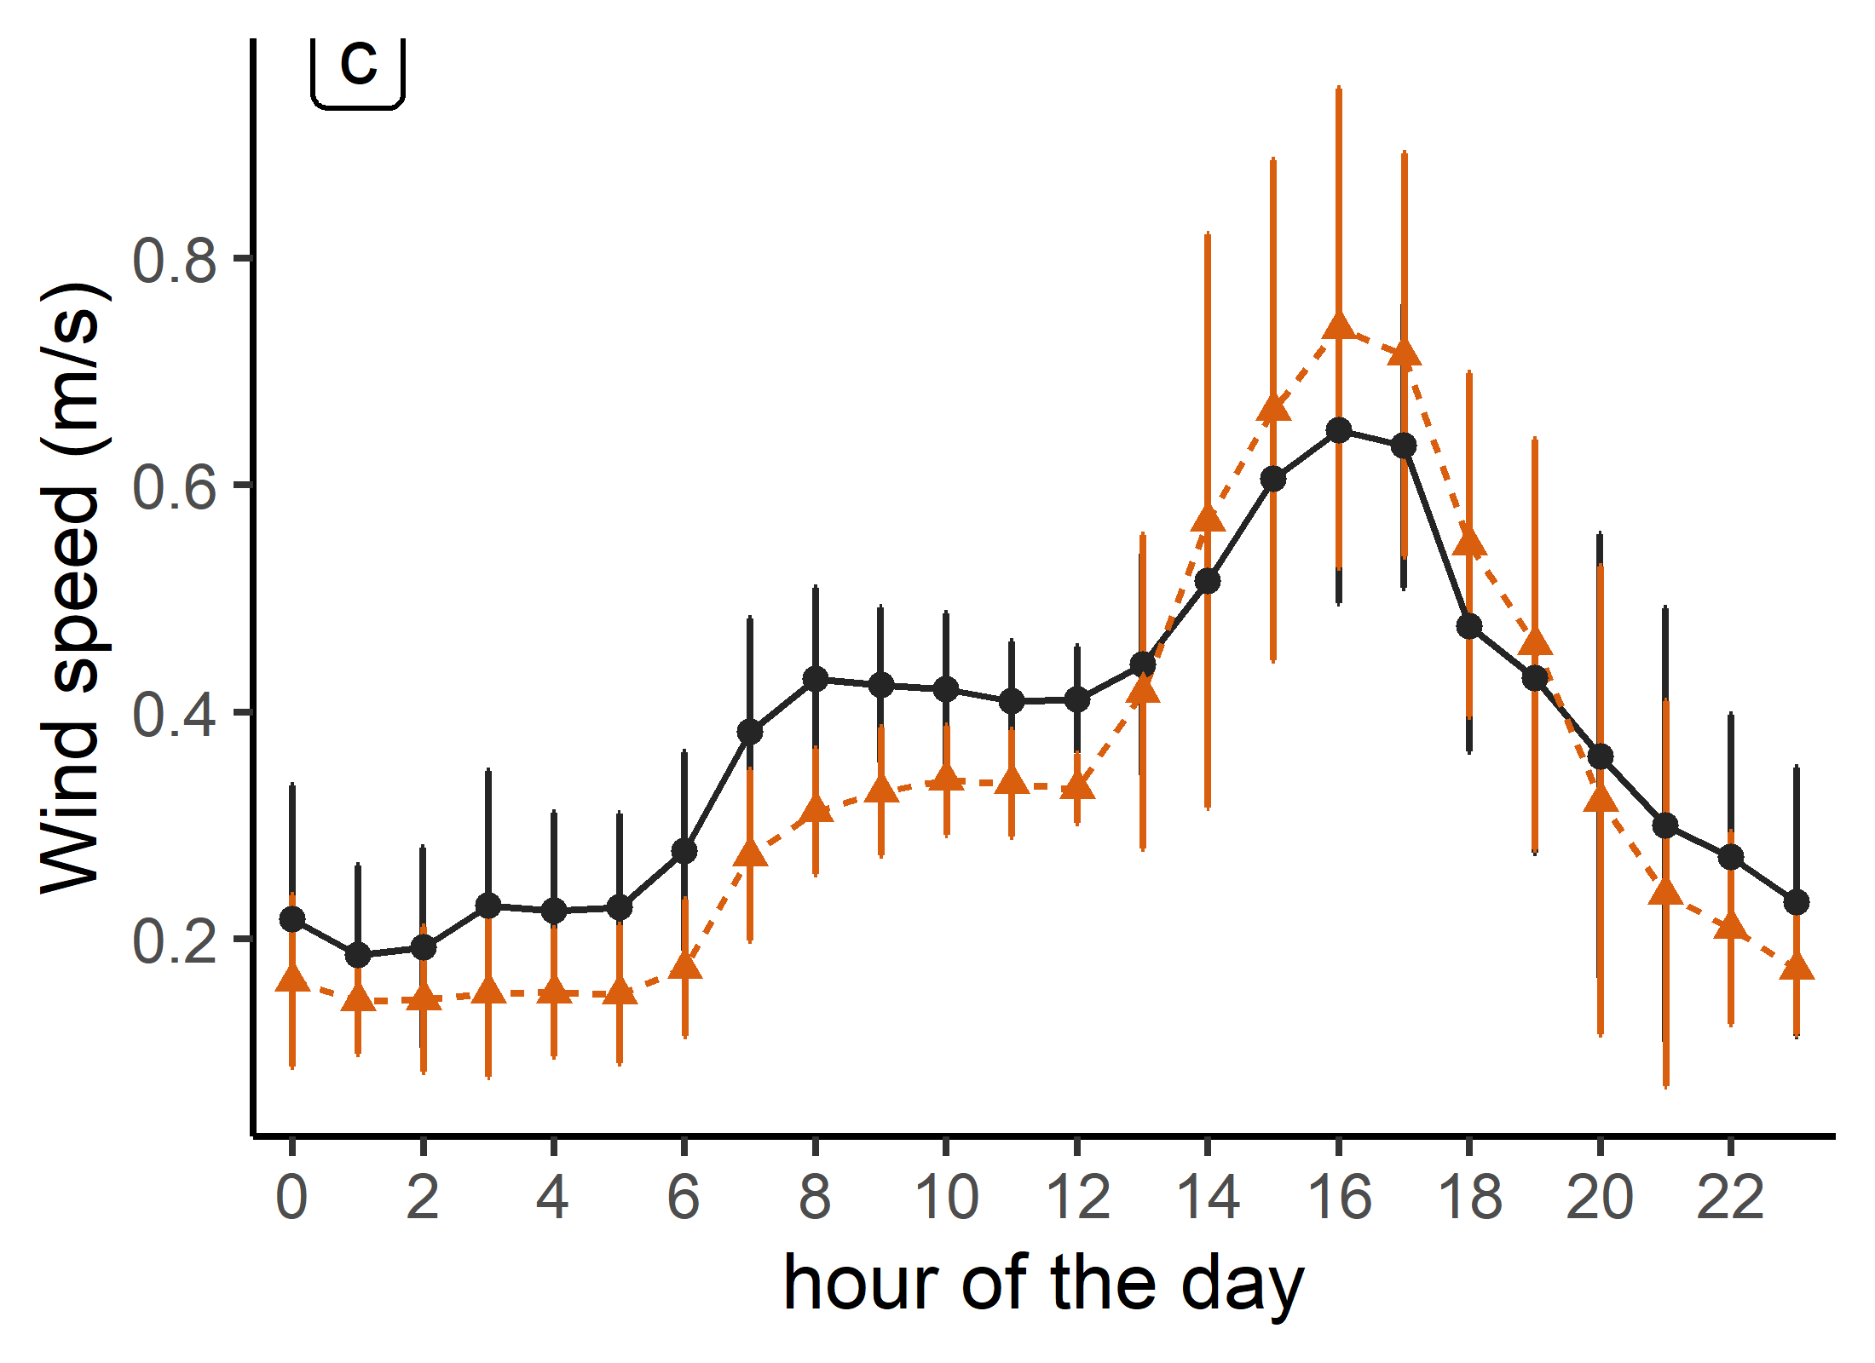
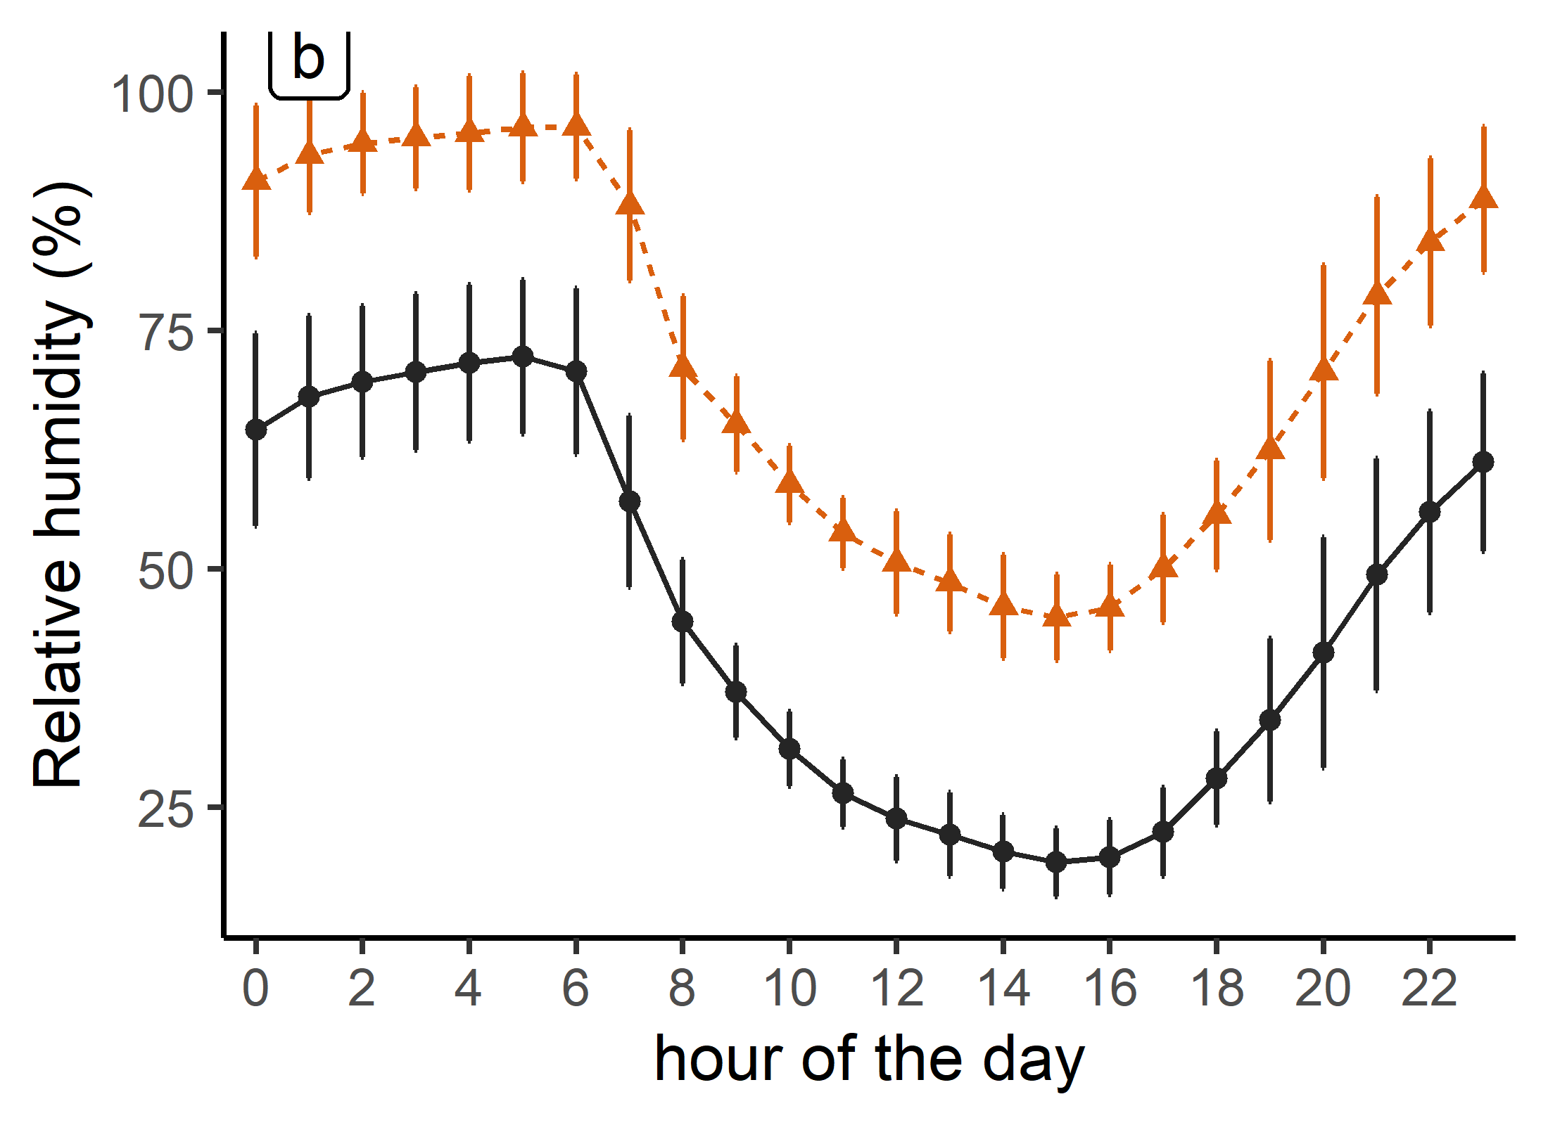
Anti hail nets effect
- 5% at Night
- 14% at Night
+ 48% overall
Notes:
Data processing: hourly data and each point represents the average of 20 days (cloudy day excluded). Bars refers to st. dev

Slide 9
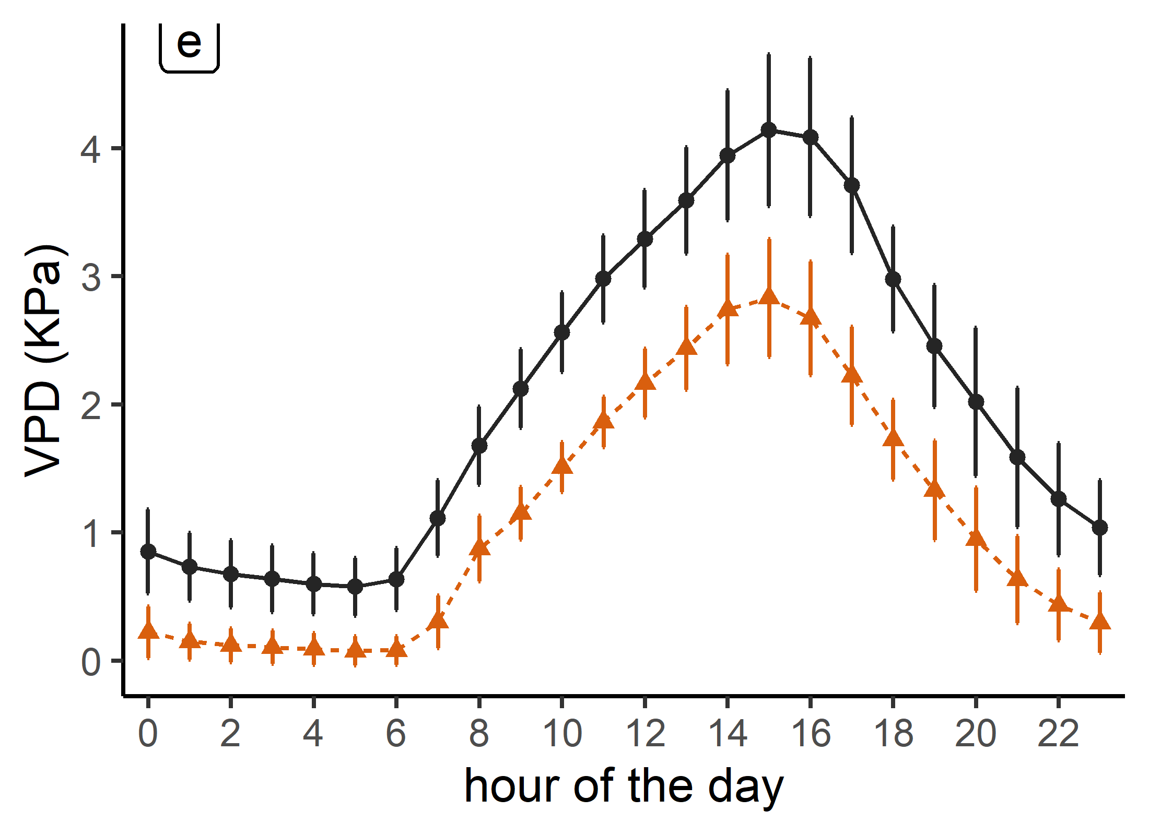
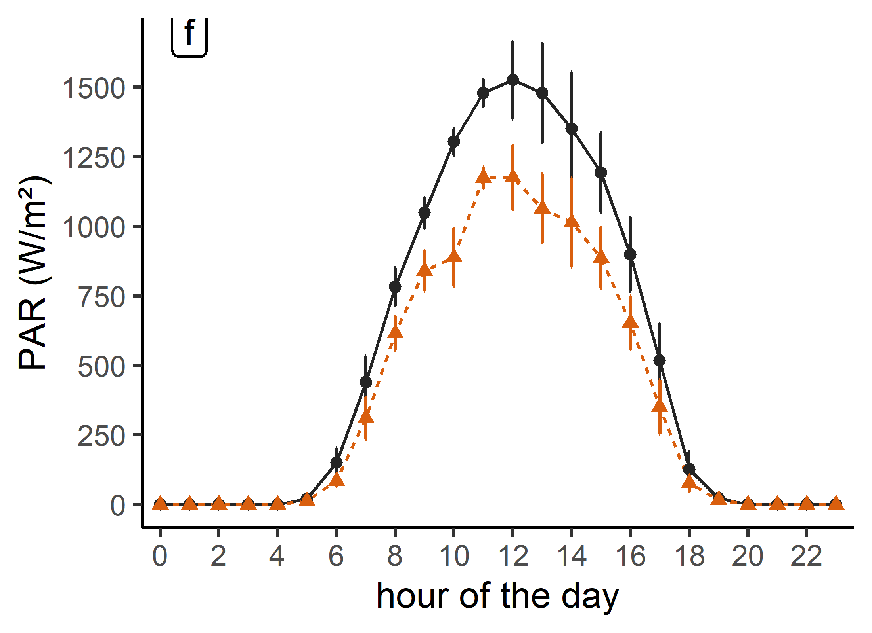
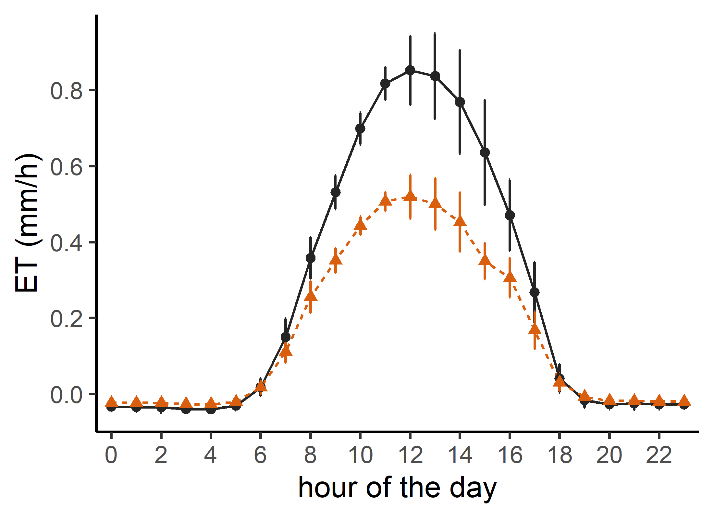
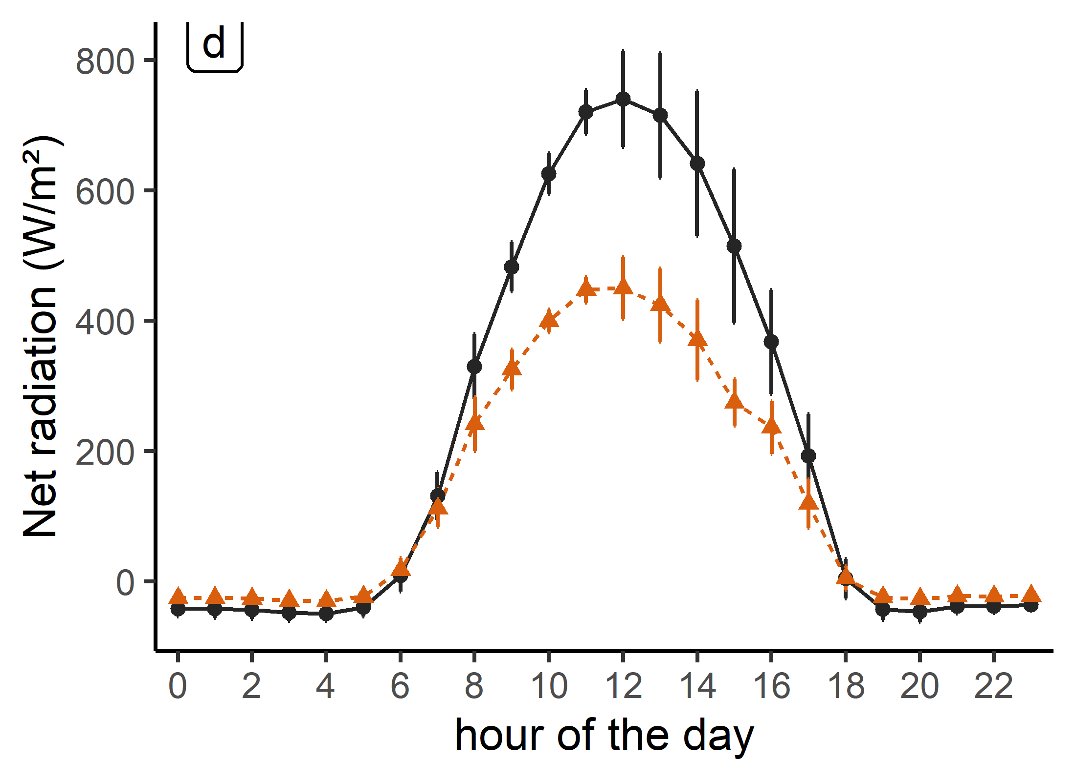
Anti hail nets effect
- 46% overall
- 26% at daytime
-39% overall
- 39% at daytime
Notes:
as expected: PAR, VPD and NR have been reduced by effect of nets
All these microclimate alterations affect the potential ET and an overall reduction by 39% under the nets (graph) was recorded. Add some reference in this regard.

Slide 10
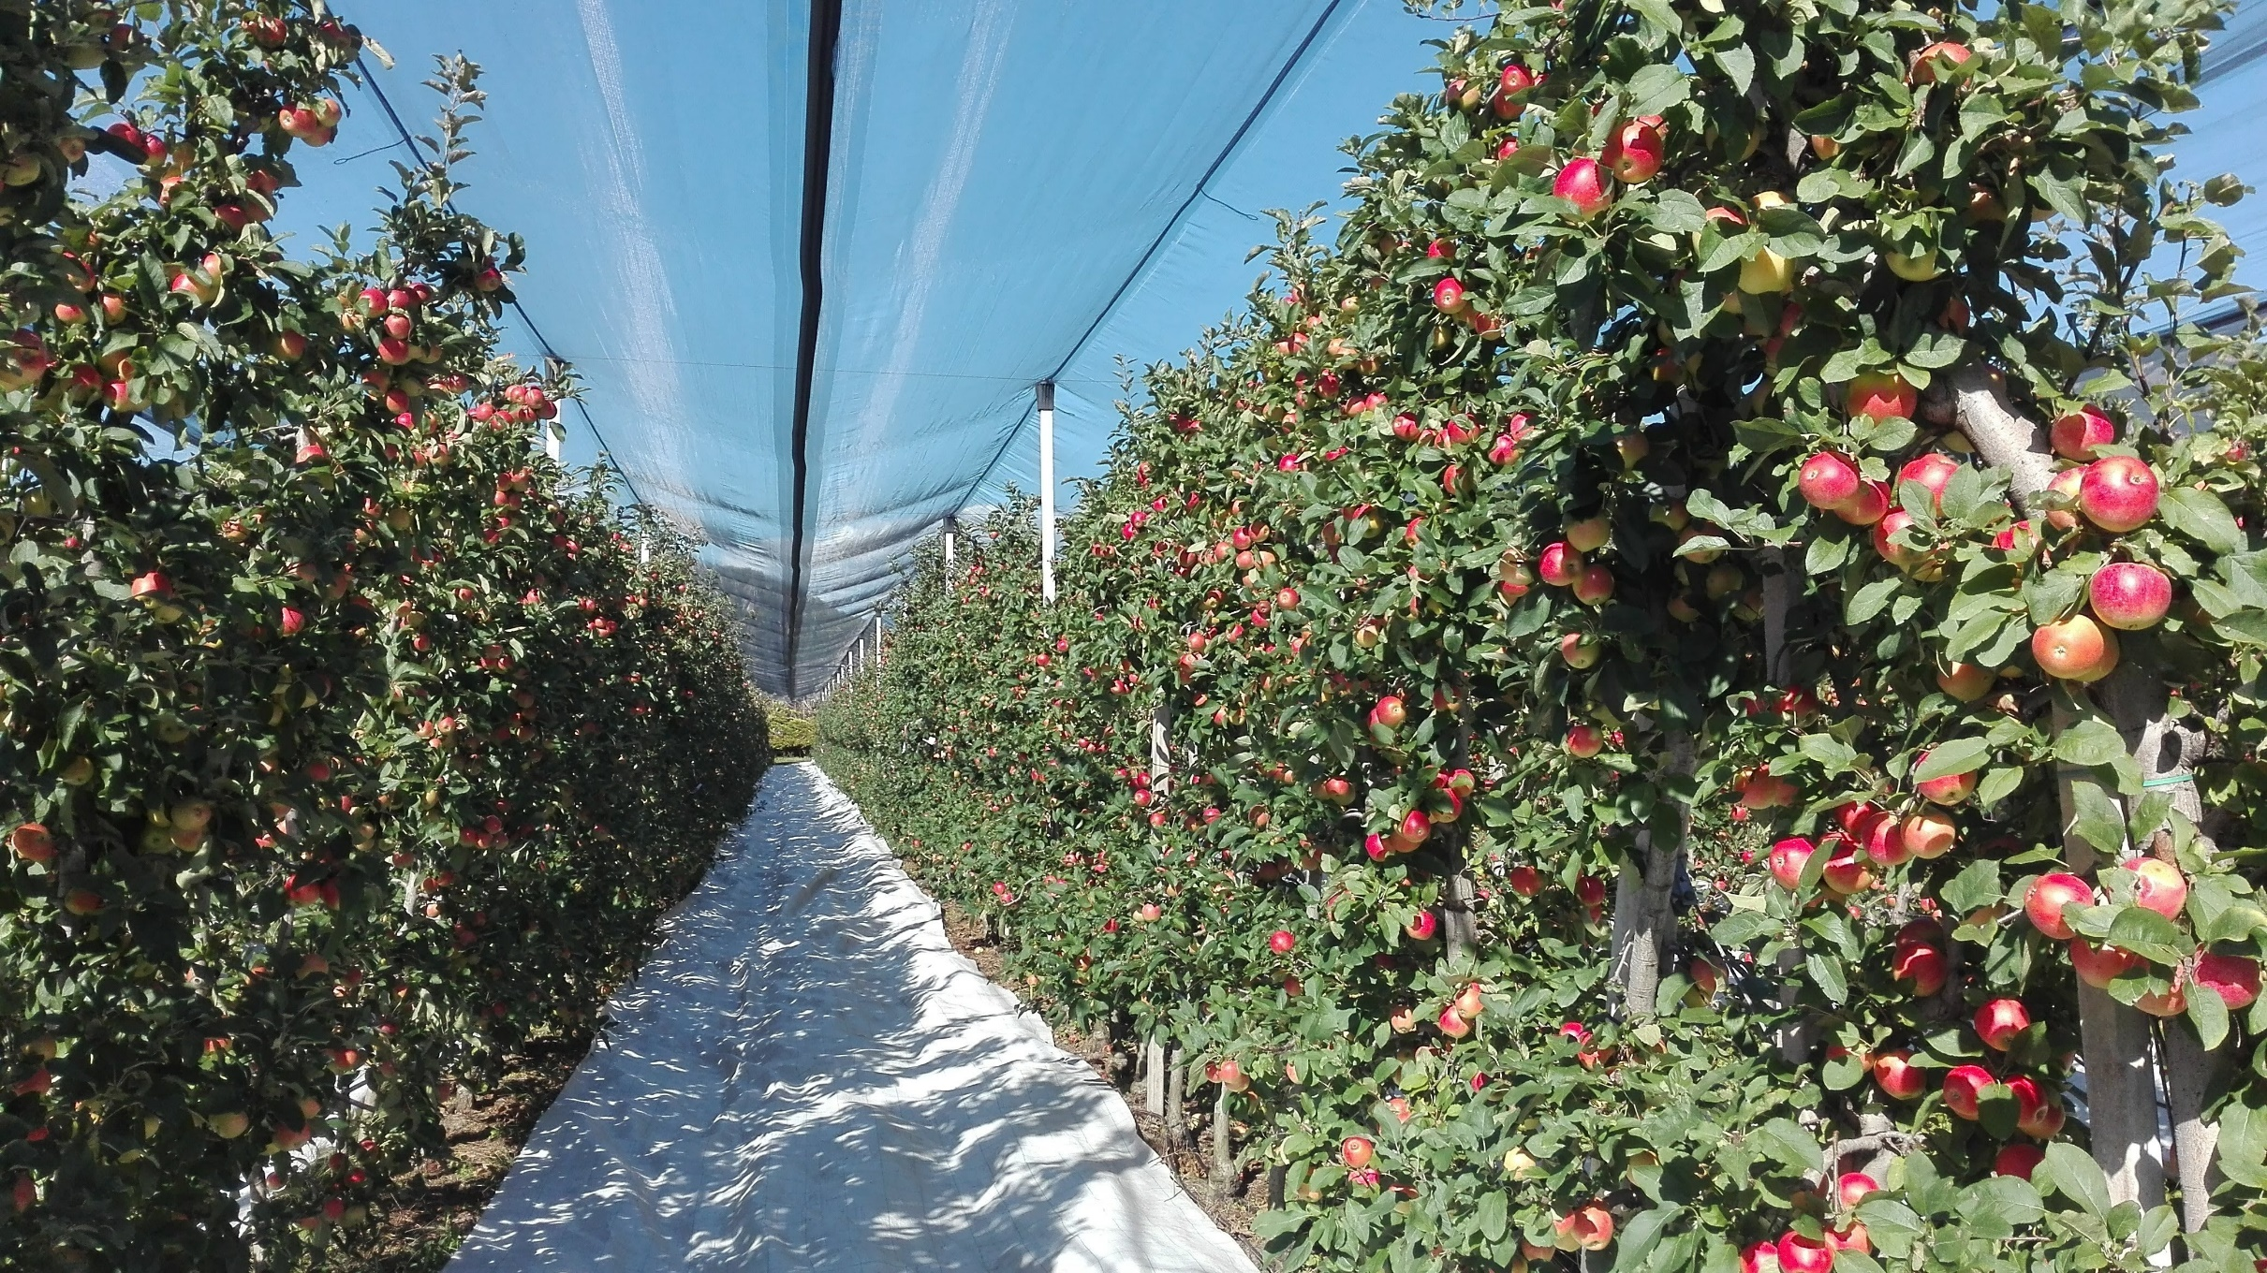

Slide 11
Ground reflective covers effect
Reflective strips placed 2-3 weeks before harvest in order to enhance the albedo and the light distribution within the canopy and improve the fruit color,
In 2019, the effect of the reflective strips on the light was studied by Shtai et al., Findings revealed that the quantity of diffuse light reflected from the orchard floor has increased mainly at 1m height from the ground.

Slide 12
Data processing:
Selecting 3 similar days (outside the nets) in terms of temperature, PAR pattern, clear sky and without precipitation, before (end of August) and just after placing the ground cover (beginning of September),
Evaluating the changes across the day (from 6 am to 6 pm), calculated as the difference between external conditions and those occurring simultaneously under the nets,
Contrasting the climatic parameter of the two series of data (given as %).
Ground reflective covers additional effect on Microclimate and ETp

Slide 13
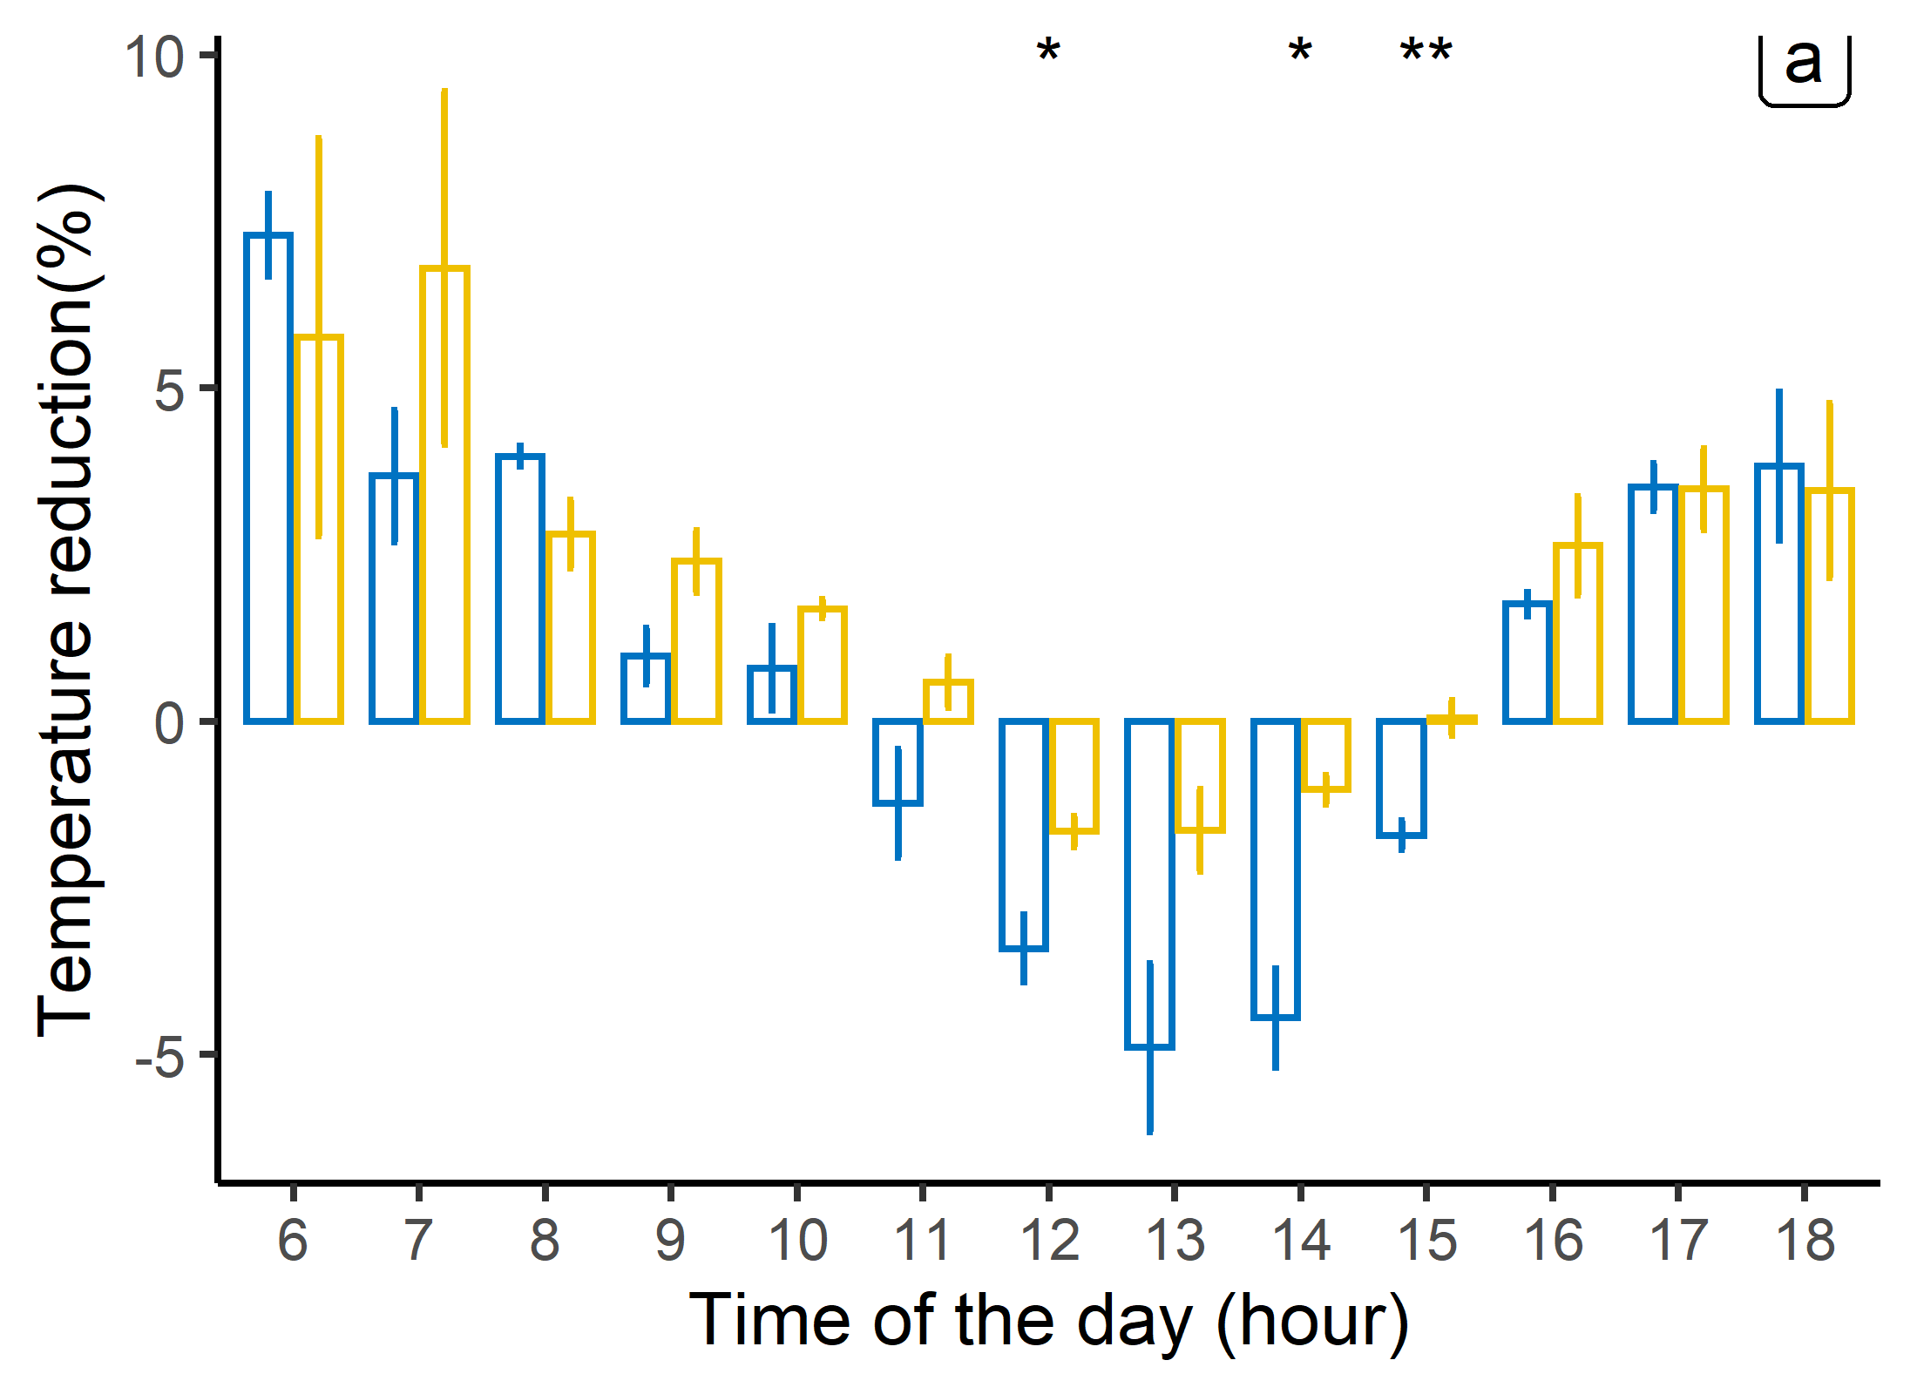
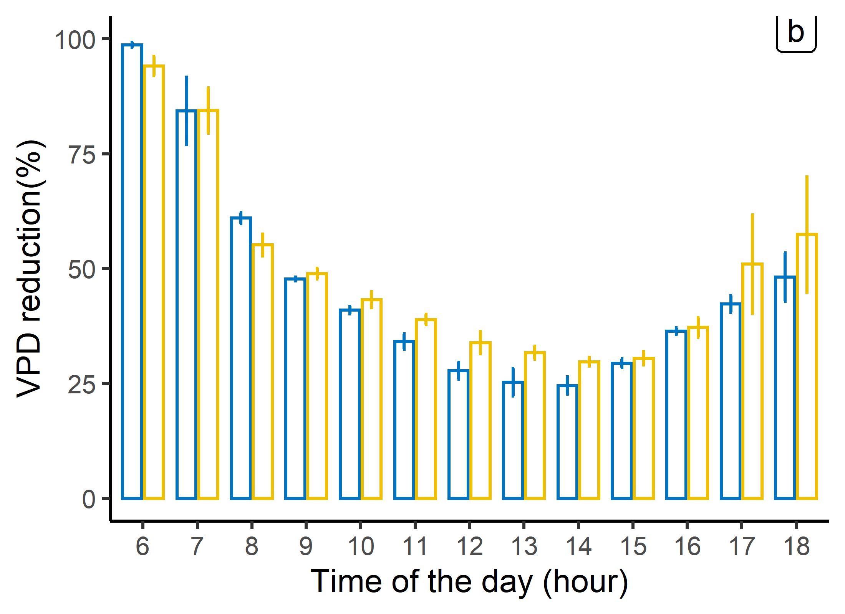
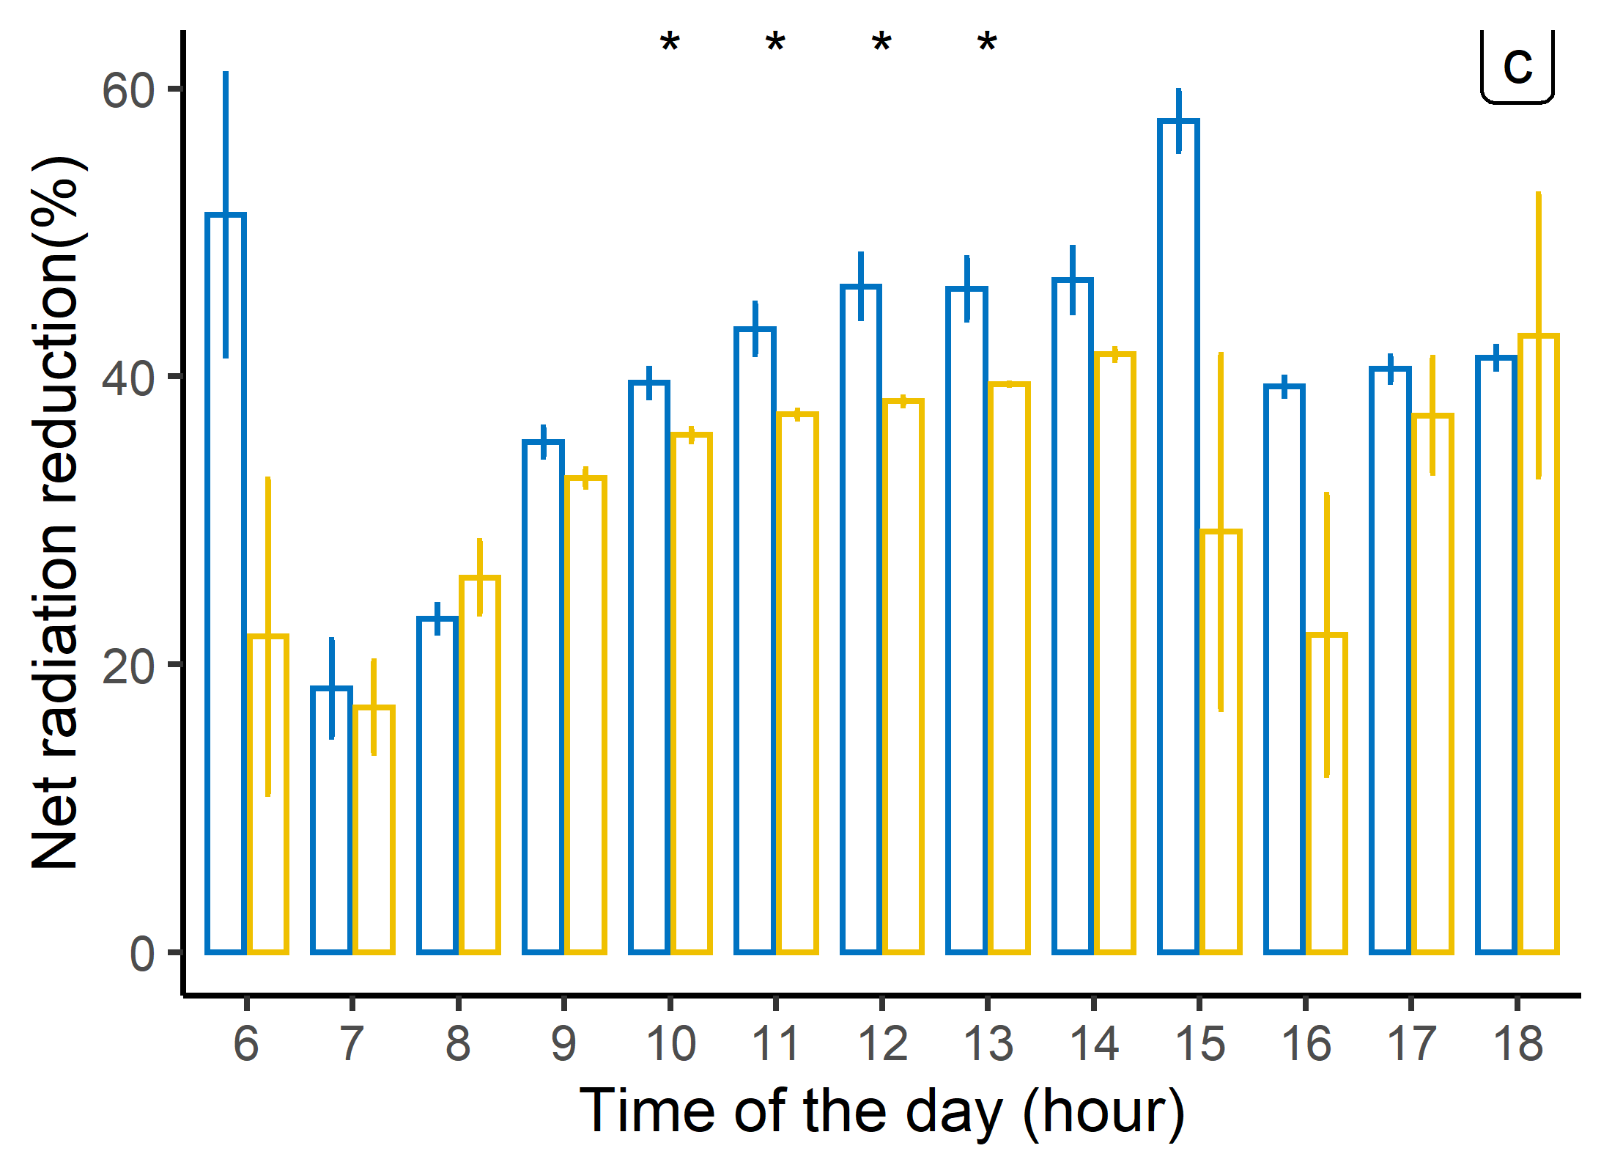
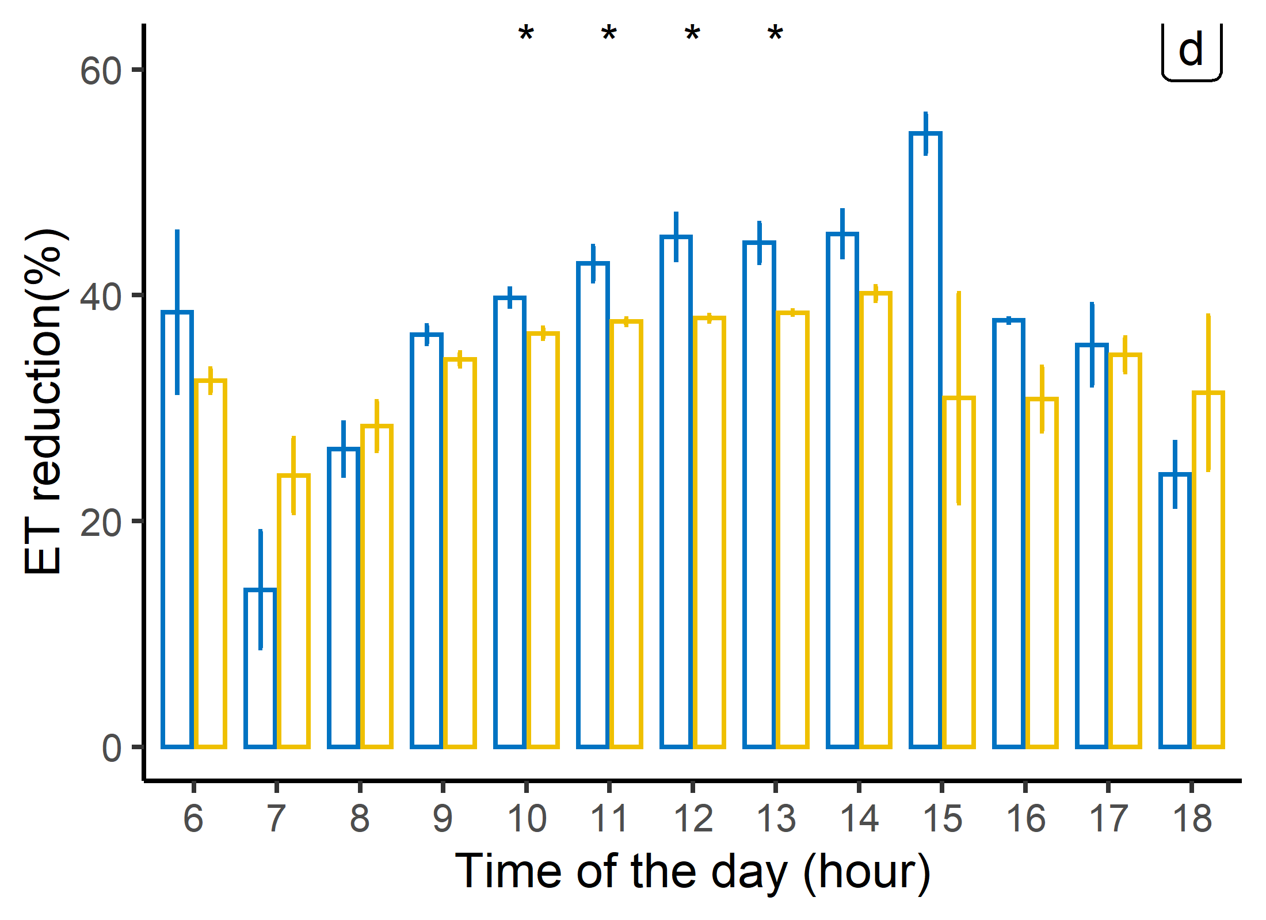
Ground reflective covers effects

Slide 14
CONCLUSION
Microclimatic changes around the tree canopy caused by the hail nets could lead to a significant reduction of water losses in the orchard and consequently of the irrigation needs.
Reflective strips, besides their recognized benefit in improving fruit color, additionally contribute to reduce the evaporative demand of the atmosphere.
Notes:
From the preliminary results of this study, we can conclude that

Slide 15
Thank you for your attention

